Slide 1
PSM Rulemaking Meeting
December 3rd, 2018

Slide 2
Today’s meeting
This is the final stakeholder meeting
Scheduled for 9:00 to noon with option to go until 3:00
We will continue to take all written comments through December 31st, 2018
Remember, you don’t have to attend a meeting to send in comments
Send comments to psmcomments@lni.wa.gov

Slide 3
Timeline for 2019
Starting January 1st, 2019
DOSH begins updating the draft language and preparing for the CR-102
Summer of 2019
The department files the CR-102
No later than December 31st, 2019
The department completes the rulemaking process and files the CR-103

Slide 4
Preparing the CR-102
Finalize the draft language
Complete a Cost Benefit Analysis (CBA) and Small Business Economic Impact Statement (SBEIS) if the SBEIS is required
Set dates for the public hearings and the length of the comment period

Slide 5
Preparing the CR-102 cont.
We will solicit input on the number and location of the public hearings
Information on public hearings will be sent out via the .Gov delivery system
CR-102 notice includes public hearing dates proposed rule language, CBA and other information

Slide 6
Preparing the CR-102 cont.
Prior to the CR-102 filing DOSH will do a refresher “Rulemaking 101”
Review public hearing/public comment process
Discuss the different options to provide comments
Identify the remaining legal requirements and deadlines that follow the public hearings
Date for this refresher is to be determined
Notifications will be sent out to all stakeholders

Slide 7
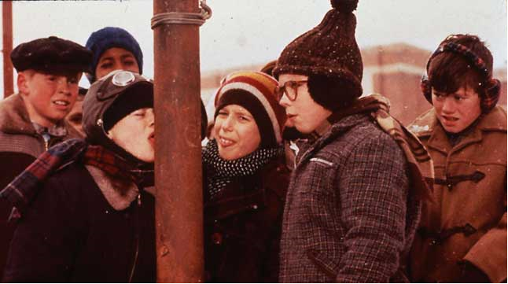
Points of contact
Tari Enos (Process questions)
Tari.Enos@lni.wa.gov
(360) 902-5541
Sally Buckingham (Technical questions)
Sally.Buckingham@lni.wa.gov
(360) 647-7322
Ryan Allen (Technical questions)
Ryan.Allen@lni.wa.gov
(360) 902-5530

Slide 8
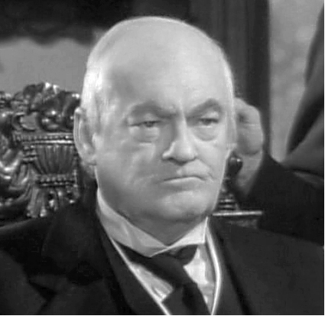
Questions?
Alan Lundeen
Alan.Lundeen@lni.wa.gov
(360) 902-4758

