Slide 1
Process Safety Advisory Committee
Overview of Industry Process Safety Management
September 21, 2015
Western States Petroleum Association // wspa.org // @wspaprez

Slide 2
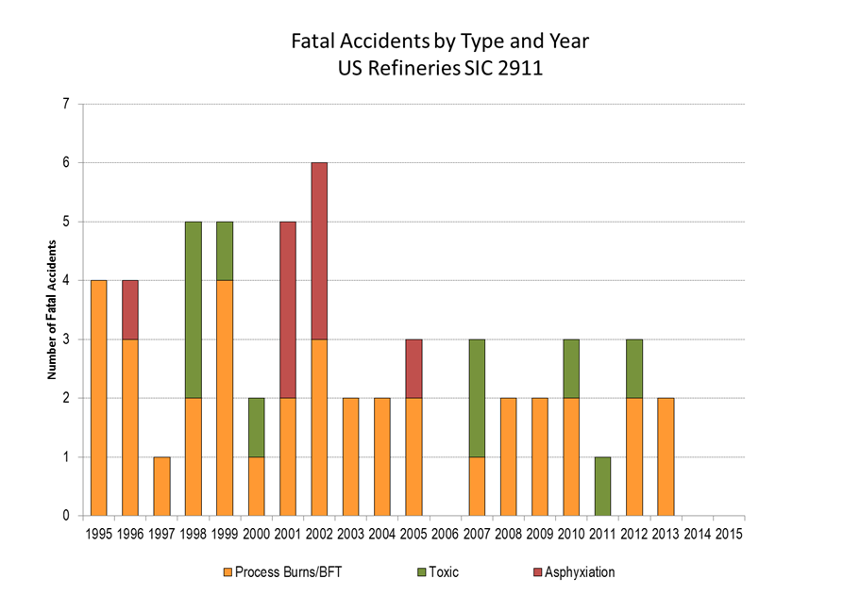
Process Safety Management

Slide 3
Organizations Improving Process Safety in Refining
American Petroleum Institute
American Fuels & Petrochemical Manufacturers
Center for Chemical Process Safety
Global Congress on Process Safety
American Institute of Chemical Engineers. Center for Chemical Process Safety
Mary Kay O’Conner Process Safety Center
Western States Petroleum Association – PSM Committee

Slide 4
Examples of Efforts
Shared learnings
committees
networks
symposiums
good practices
Recommended Standards
metallurgical
process
engineering

Slide 5
API Standards for Refining
Oil and gas companies, manufacturers and suppliers, contractors and consultants, representatives of government agencies and academia.
Over 160- published- recommended procedures, standards, technical specifications and reports.

